Slide 1

AI 2136/CE 2136/ IT 2136
DATA STRUCTURES & ALGORITHMS
TREE

Slide 2
Introduction to TREE
So far, we have discussed linear data structures such as arrays, strings, stacks, and queues. Now, we will learn about a non-linear data structure called tree. A tree is a structure which is mainly used to store data that is hierarchical in nature. We will first discuss general trees and then binary trees. These binary trees are used to form binary search trees and heaps. They are widely used to manipulate arithmetic expressions, construct symbol tables, and for syntax analysis.

Slide 3
CONTD…
A tree is recursively defined as a set of one or more nodes where one node is designated as the root of the tree and all the remaining nodes can be partitioned into non-empty sets each of which is a sub-tree of the root. See in the next slide shows a tree where node A is the root node; nodes B, C, and D are children of the root node and form sub-trees of the tree rooted at node A.

Slide 4
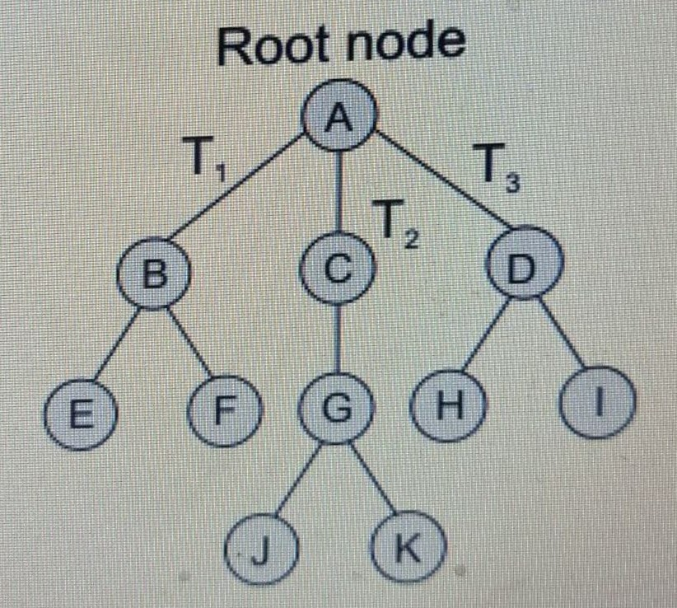

Slide 5
Tree data structure may be defined as- Tree is a non-linear data structure which organizes data in a hierarchical structure and this is a recursive definition. OR A tree is a connected graph without any circuits. OR If in a graph, there is one and only one path between every pair of vertices, then graph is called as a tree.

Slide 6
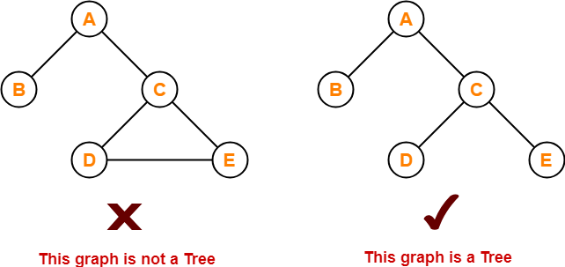
Example

Slide 7
Properties
The important properties of tree data structure are-
There is one and only one path between every pair of vertices in a tree.
A tree with n vertices has exactly (n-1) edges.
A graph is a tree if and only if it is minimally connected.
Any connected graph with n vertices and
(n-1) edges is a tree.

Slide 8
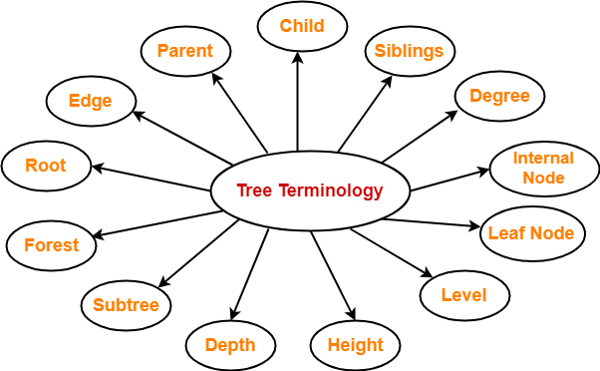
Tree Terminology
The important terms related to tree data structure are-

Slide 9
1. Root-
The first node from where the tree originates is called as a root node.
In any tree, there must be only one root node.
We can never have multiple root nodes in a tree data structure.

Slide 10
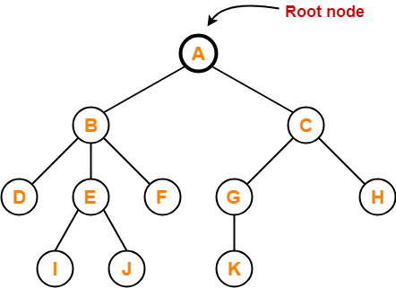

Slide 11
2. Edge-
The connecting link between any two nodes is called as an edge.
In a tree with n number of nodes, there are exactly (n-1) number of edges.

Slide 12
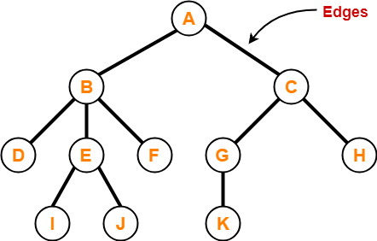

Slide 13
3. Parent-
The node which has a branch from it to any other node is called as a parent node.
In other words, the node which has one or more children is called as a parent node.
In a tree, a parent node can have any number of child nodes.

Slide 14
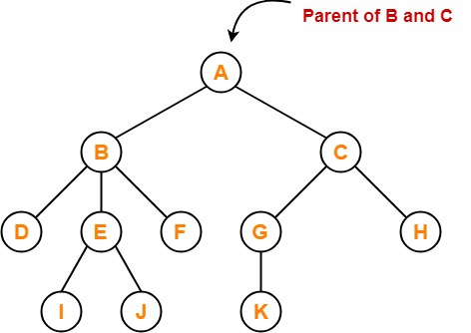

Slide 15
In the previous slide,
Node A is the parent of nodes B and C
Node B is the parent of nodes D, E and F
Node C is the parent of nodes G and H
Node E is the parent of nodes I and J
Node G is the parent of node K

Slide 16
4. Child-
The node which is a descendant of some node is called as a child node.
All the nodes except root node are child nodes.

Slide 17
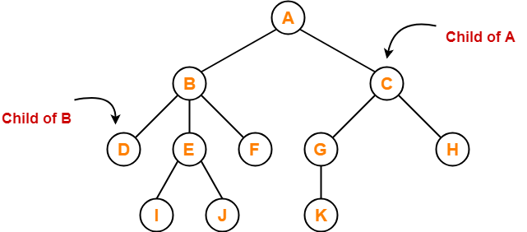

Slide 18
In the previous slide,
Nodes B and C are the children of node A
Nodes D, E and F are the children of node B
Nodes G and H are the children of node C
Nodes I and J are the children of node E
Node K is the child of node G

Slide 19
5. Siblings-
Nodes which belong to the same parent are called as siblings.
In other words, nodes with the same parent are sibling nodes.

Slide 20
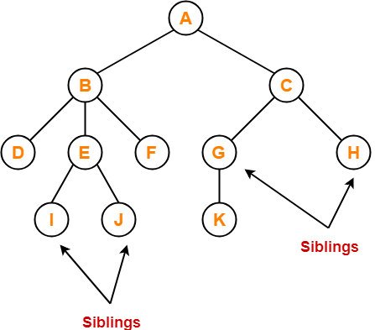

Slide 21
In the previous slide,
Nodes B and C are siblings
Nodes D, E and F are siblings
Nodes G and H are siblings
Nodes I and J are siblings

Slide 22
6. Degree-
Degree of a node is the total number of children of that node.
Degree of a tree is the highest degree of a node among all the nodes in the tree.

Slide 23
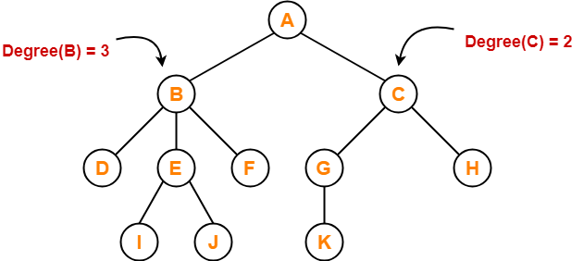

Slide 24
In the previous slide,
Degree of node A = 2
Degree of node B = 3
Degree of node C = 2
Degree of node D = 0
Degree of node E = 2
Degree of node F = 0
Degree of node G = 1
Degree of node H = 0
Degree of node I = 0
Degree of node J = 0
Degree of node K = 0

Slide 25
7. Internal Node-
The node which has at least one child is called as an internal node.
Internal nodes are also called as non-terminal nodes.
Every non-leaf node is an internal node.

Slide 26
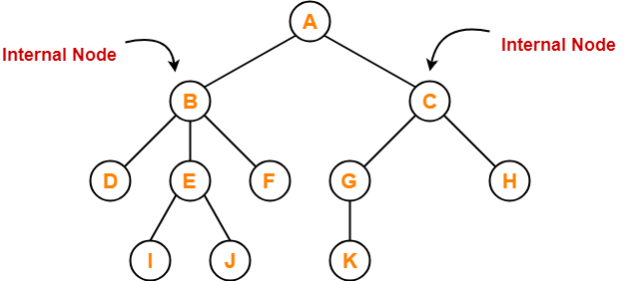

Slide 27
In the previous slide,
Node A,
Node B,
Node C,
Node E and
Node G are internal nodes.

Slide 28
8. Leaf Node-
The node which does not have any child is called as a leaf node.
Leaf nodes are also called as external nodes or terminal nodes.

Slide 29
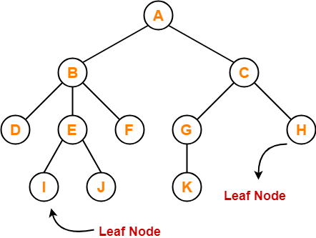

Slide 30
In the previous slide,
Nodes D, I, J, F, K and H are leaf nodes.

Slide 31
9. Level-
In a tree, each step from top to bottom is called as level of a tree.
The level count starts with 0 and increments by 1 at each level or step.

Slide 32
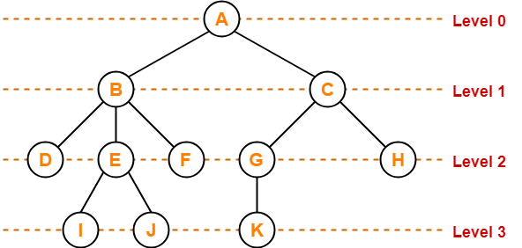

Slide 33
10. Height-
Total number of edges that lies on the longest path from any leaf node to a particular node is called as height of that node.
Height of a tree is the height of root node.
Height of all leaf nodes = 0

Slide 34
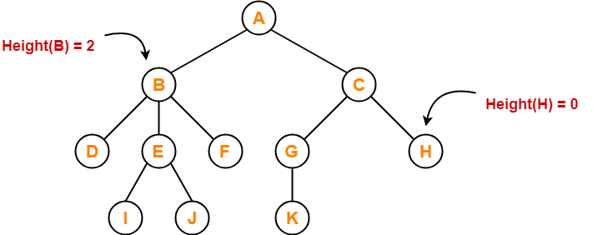

Slide 35
In the previous slide,
Height of node A = 3
Height of node B = 2
Height of node C = 2
Height of node D = 0
Height of node E = 1
Height of node F = 0
Height of node G = 1
Height of node H = 0
Height of node I = 0
Height of node J = 0
Height of node K = 0

Slide 36
11. Depth-
Total number of edges from root node to a particular node is called as depth of that node.
Depth of a tree is the total number of edges from root node to a leaf node in the longest path.
Depth of the root node = 0
The terms “level” and “depth” are used interchangeably.

Slide 37
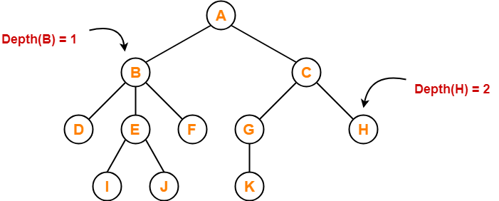

Slide 38
In the previous slide,
Depth of node A = 0
Depth of node B = 1
Depth of node C = 1
Depth of node D = 2
Depth of node E = 2
Depth of node F = 2
Depth of node G = 2
Depth of node H = 2
Depth of node I = 3
Depth of node J = 3
Depth of node K = 3

Slide 39
12. Subtree-
In a tree, each child from a node forms a subtree recursively.
Every child node forms a subtree on its parent node.

Slide 40
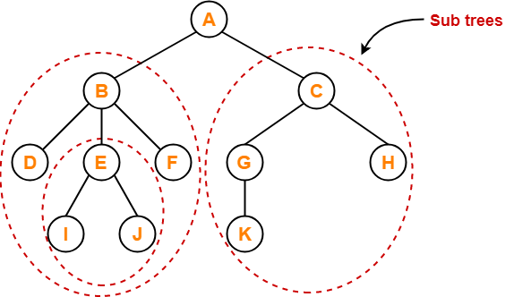

Slide 41
13. Forest-
A forest is a set of disjoint trees.

Slide 42
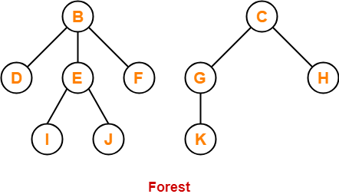

Slide 43
TYPES OF TREES
Trees are of following 6 types:
1. General trees
2. Forests
3. Binary trees
4. Binary search trees
5. Expression trees
6. Tournament trees

Slide 44
General Trees
General trees are data structures that store elements hierarchically. The top node of a tree is the root node and each node, except the root, has a parent. A node in a general tree (except the leaf nodes) may have zero or more sub-trees. General trees which have 3 sub-trees per node are called ternary trees. However, the number of sub-trees for any node may be variable. For example, a node can have 1 sub-tree, whereas some other node can have 3 sub-trees.
Although general trees can be represented as ADTs, there is always a problem when another sub-tree is

Slide 45
added to a node that already has the maximum number of sub-trees attached to it. Even the algorithms for searching, traversing, adding, and deleting nodes become much more complex as there are not just two possibilities for any node but multiple possibilities.
To overcome the complexities of a general tree, it may be represented as a graph data structure (to be discussed later), thereby losing many of the advantages of the tree processes. Therefore, a better option is to convert general trees into binary trees.

Slide 46
Contd…
A general tree when converted to a binary tree may not end up being well formed or full, but the advantages of such a conversion enable the programmer to use the algorithms for processes that are used for binary trees with minor modifications.

Slide 47
Forest…
A forest is a disjoint union of trees. A set of disjoint trees (or forests) is obtained by deleting the root and the edges connecting the root node to nodes at level 1.
We have already seen that every node of a tree is the root of some sub-tree. Therefore, all the sub-trees immediately below a node form a forest.

Slide 48
A forest can also be defined as an ordered set of zero or more general trees. While a general tree must have a root, a forest on the other hand may be empty because by definition it is a set, and sets can be empty. We can convert a forest into a tree by adding a single node as the root node of the tree. For example, in the next slide. (a) shows a forest and (b) shows the corresponding tree. Similarly, we can convert a general tree into a forest by deleting the root node of the tree.

Slide 49
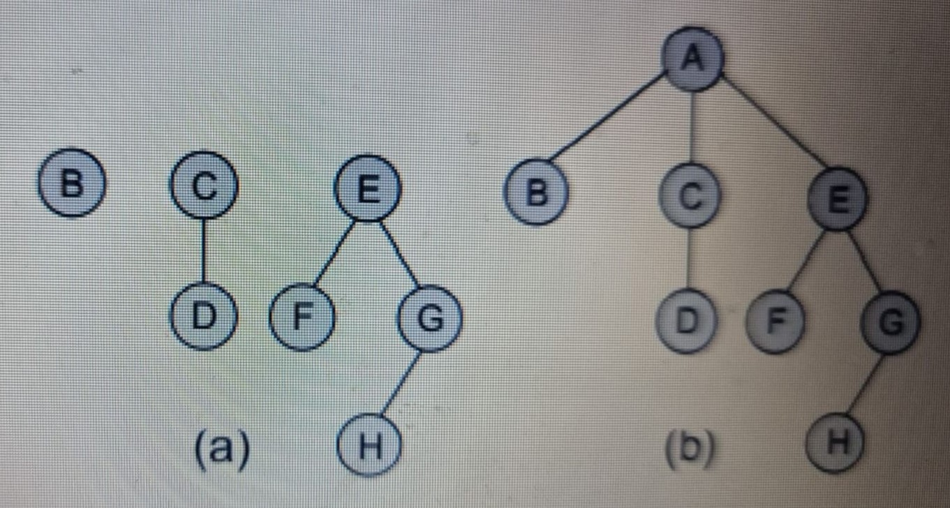

Slide 50
Binary Trees
A binary tree is a data structure that is defined as a collection of elements called nodes. In a binary tree, the topmost element is called the root node, and each node has 0, 1, or at the most 2 children. A node that has zero children is called a leaf node or a terminal node. Every node contains a data element, a left pointer which points to the left child, and a right pointer which points to the right child. The root element is pointed by a 'root' pointer. If root = NULL, then it means the tree is empty.

Slide 51
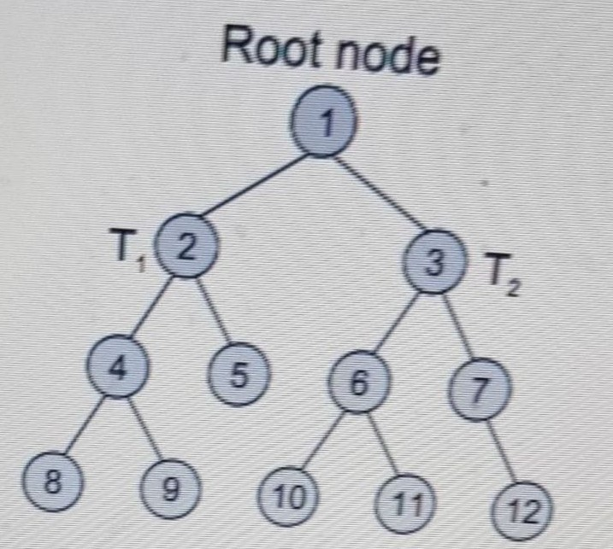

Slide 52
In the previous slide see a binary tree. In the figure, R is the root node and the two trees T1 and T2 are called the left and right sub-trees of R. T1 is said to be the left successor of R. Likewise, T2 is called the right successor of R.
Note that the left sub-tree of the root node consists of the nodes: 2, 4, 5, 8, and 9. Similarly, the right sub-tree of the root node consists of nodes: 3, 6, 7, 10, 11, and 12.

Slide 53
In the tree, root node 1 has two successors: 2 and 3. Node 2 has two successor nodes: 4 and 5. Node 4 has two successors: 8 and 9. Node 5 has no successor. Node 3 has two successor nodes: 6 and 7. Node 6 has two successors: 10 and 11. Finally, node 7 has only one successor: 12.
A binary tree is recursive by definition as every node in the tree contains a left sub-tree and a right sub-tree. Even the terminal nodes contain an empty left sub-tree and an empty right sub-tree. Look at binary tree in the previous slide, nodes 5, 8, 9, 10, 11, and 12 have no successors and thus said to have empty sub-trees.

Slide 54
Terminology
Parent: If N is any node in T that has left successor S1 and right successor S2, then N is called the parent of S1 and S2. Correspondingly, S1 and S2 are called the left child and the right child of N. Every node other than the root node has a parent.

Slide 55
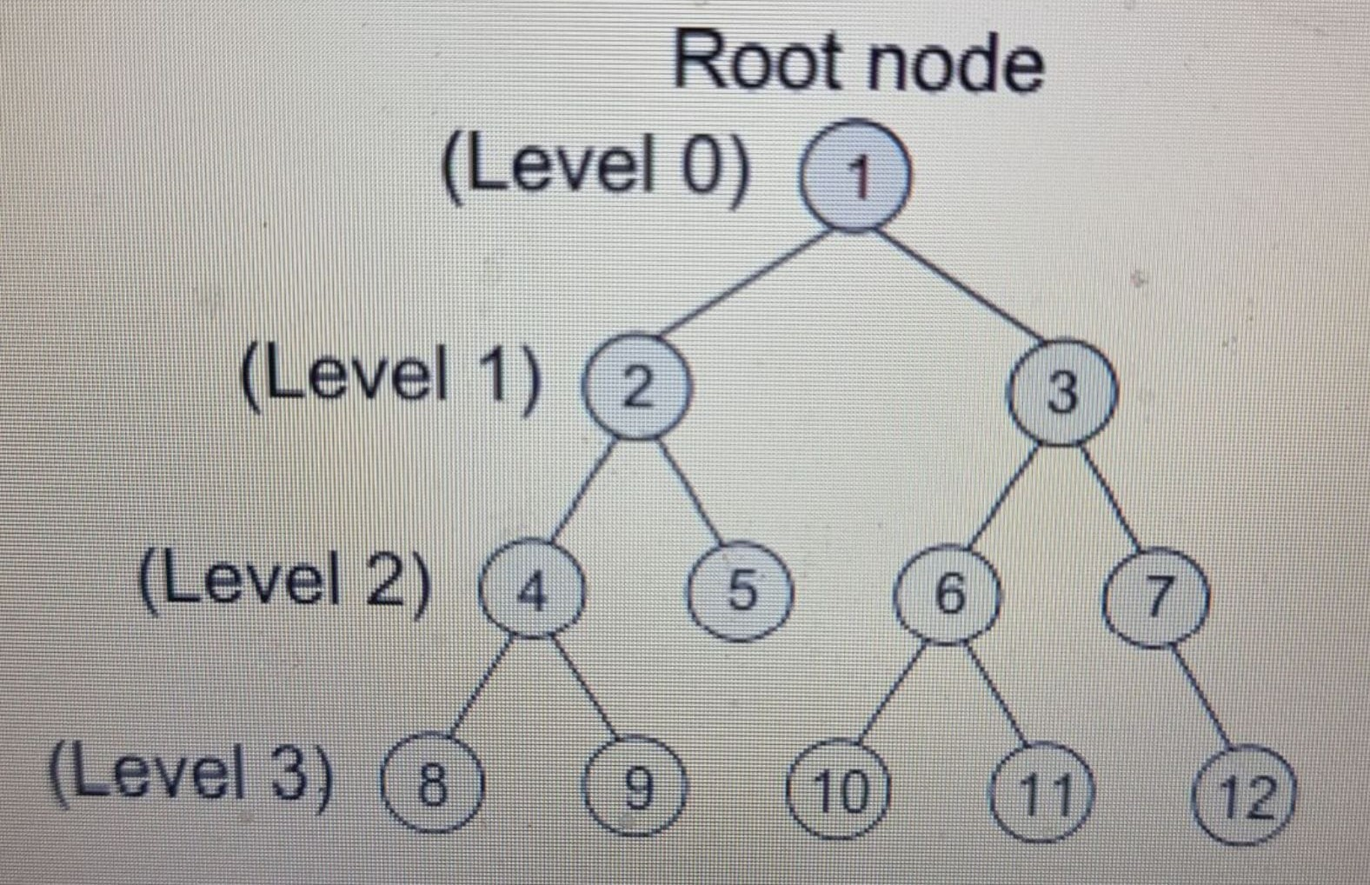

Slide 56
Level number: Every node in the binary tree is assigned a level number in previous slide. The root node is defined to be at level 0. The left and the right child of the root node have a level number 1. Similarly, every node is at one level higher than its parents. So all child nodes are defined to have level number as parent's level number + 1

Slide 57
Degree of a node: It is equal to the number of children that a node has. The degree of a leaf node is zero. For example, in the tree, degree of node 4 is 2, degree of node 5 is zero and degree of node 7 is 1.
Sibling: All nodes that are at the same level and share the same parent are called siblings (children from same parent). For example, nodes 2 and 3; nodes 4 and 5; nodes 6 and 7; nodes 8 and 9; and nodes 10 and 11 are siblings.

Slide 58
Creating a Binary Tree from a General Tree
The rules for converting a general tree to a binary tree are given below. Note that a general tree is converted into a binary tree and not a binary search tree.
Rule 1: Root of the binary tree = Root of the general tree
Rule 2: Left child of a node = Leftmost child of the node in the binary tree in the general tree
Rule 3: Right child of a node in the binary tree = Right sibling of the node in the general tree.

Slide 59

Convert the given general tree into a binary tree
Step 1: Node A is the root of the general tree, so it will also be the root of the binary tree.

Slide 60
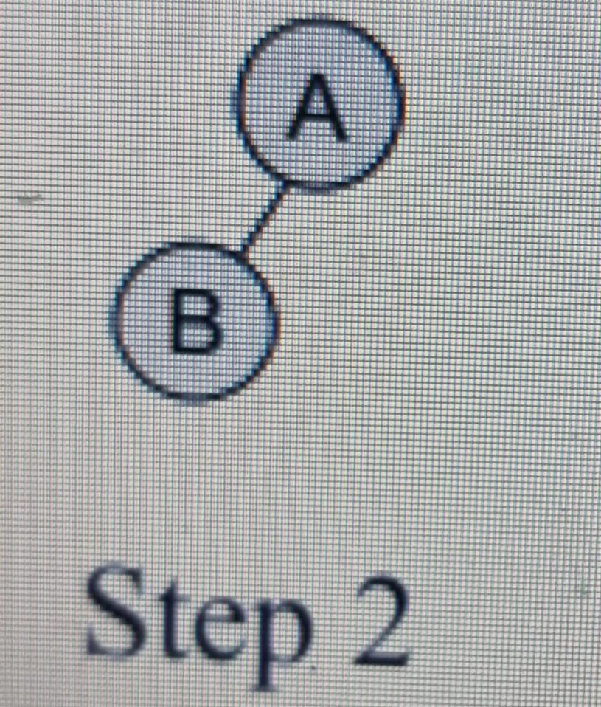
Step 2: Left child of node A is the leftmost child of node A in the general tree and right child of node A is the right sibling of the node A in the general tree. Since node A has no right sibling in the general tree, it has no right child in the binary tree.

Slide 61
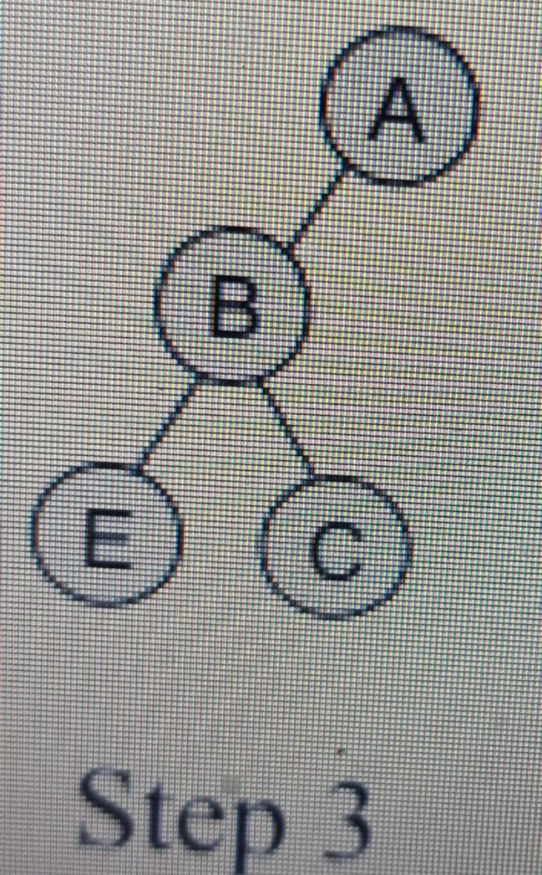
Step 3: Now process node B. Left child of B is E and its right child is C (right sibling in general tree).

Slide 62
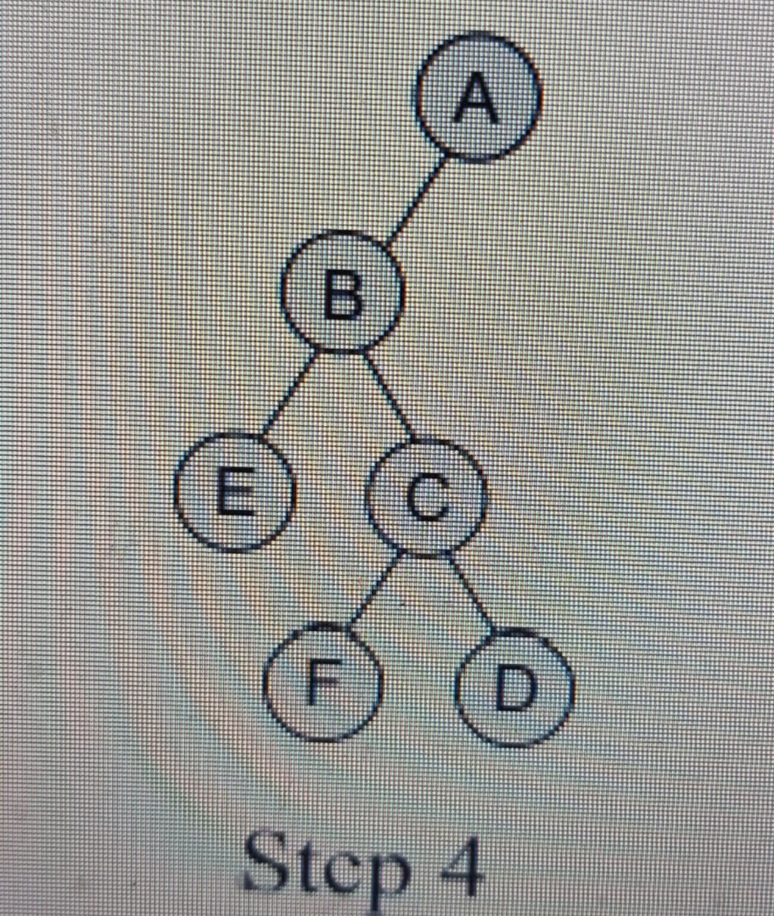
Step 4: Now process node C. Left child of C is F (leftmost child) and its right child is D (right sibling in general tree).

Slide 63
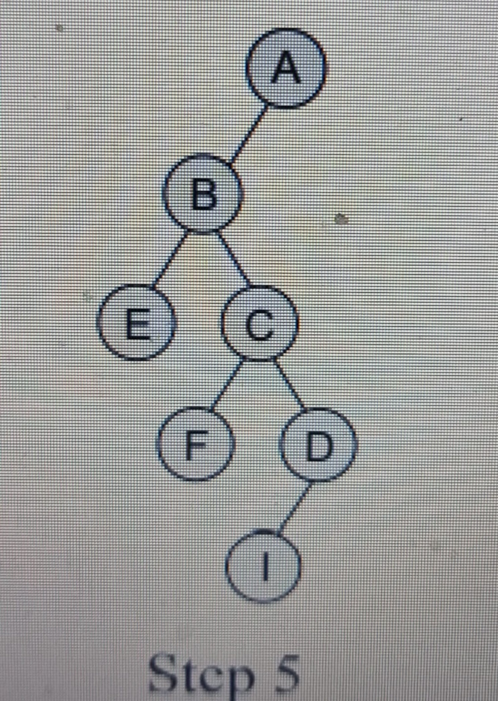
Step 5: Now process node D. Left child of D is I (leftmost child). There will be no right child of D because it has no right sibling in the general tree.

Slide 64
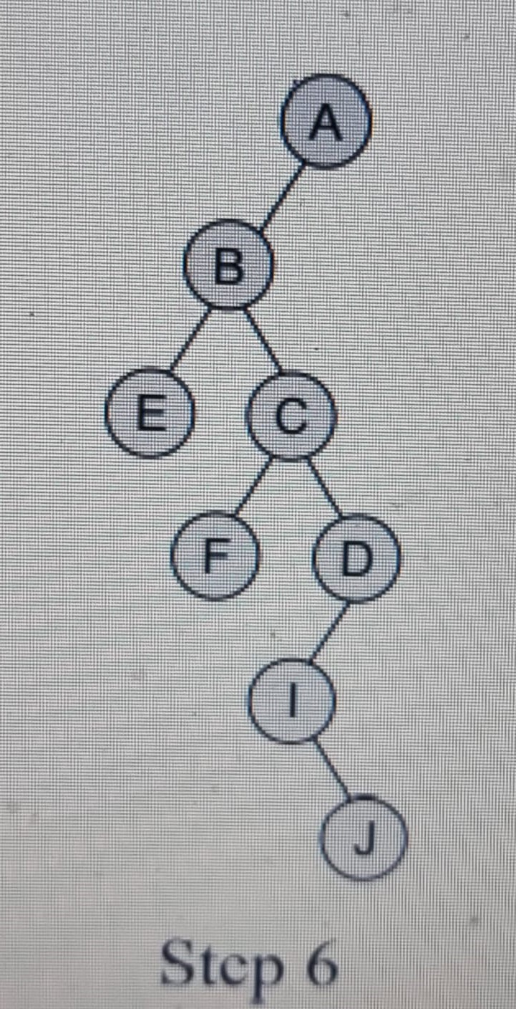
Step 6: Now process node I. There will be no left child of I in the binary tree because I has no left child in the general tree. However, I has a right sibling J, so it will be added as the right child of I.

Slide 65
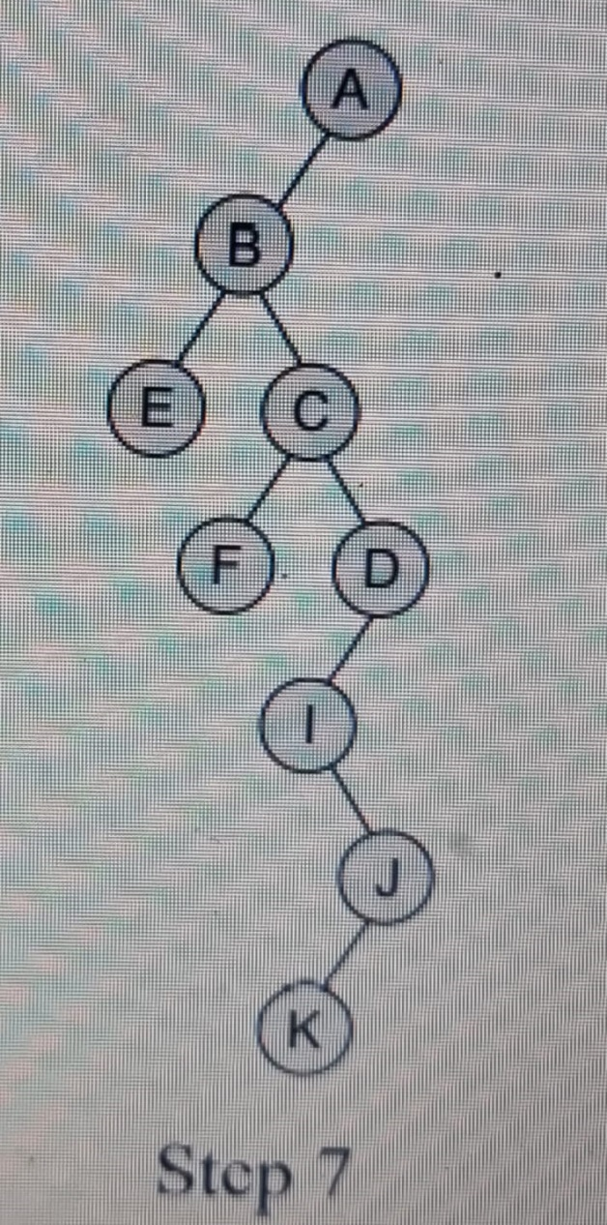
Step 7: Now process node J. Left child of J is K (leftmost child). There will be no right child of J because it has no right sibling in the general tree.

Slide 66
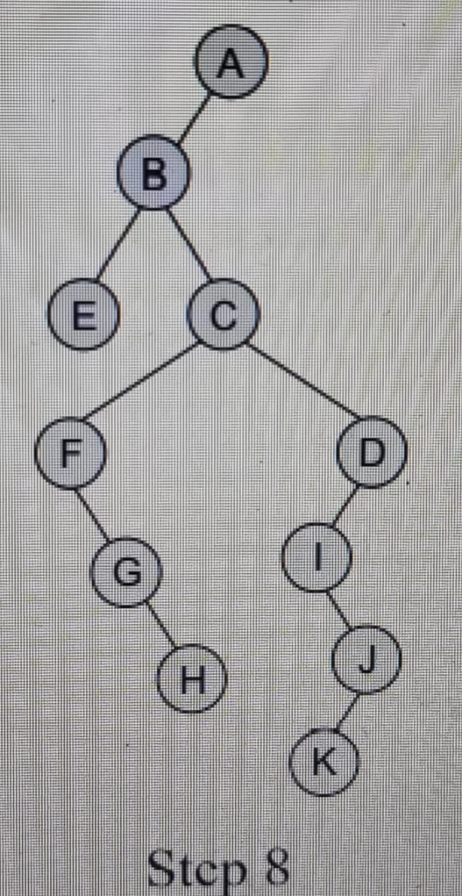
Step 8: Now process all the unprocessed nodes (E, F, G, H, K) in the same fashion, so the resultant binary tree can be given as follows.

Slide 67


